Slide 1
Fuzzy-Search Engine
AN Error-Tolerant Word Retrieval
By:
2520030159 – B. HEMA SRI
2520030371 – P. HAVISHAA REDDY

Slide 2
INPUT AND OUTPUT CONTENT
Input: A dictionary , query word ,a maximum edit distance value.
Output: A ranked list of similar words from the dictionary. The ranking is based on how close each word is to the query (fewer edits = higher rank).

Slide 3
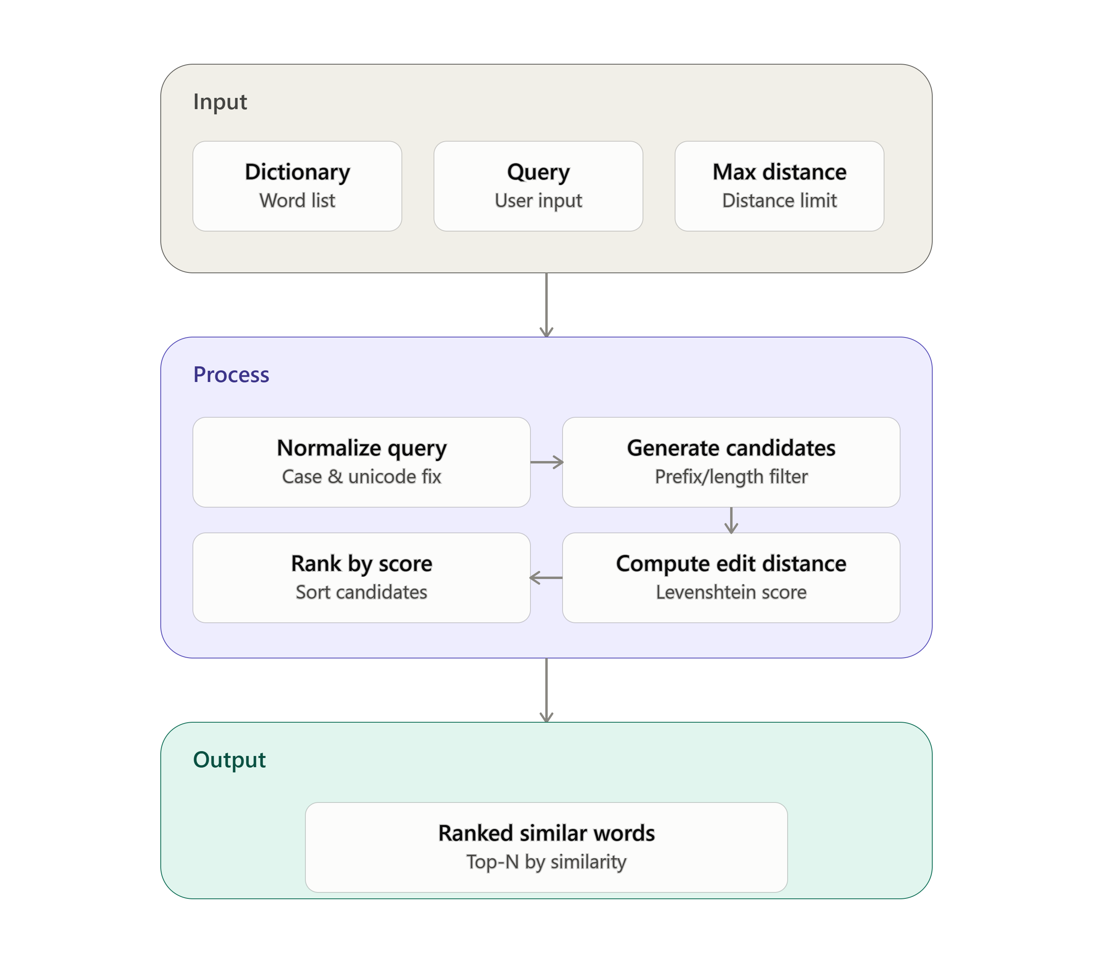
PROJECT FLOW DIAGRAM:

Slide 4
PROJECT SUMMARY:
The fuzzy search system takes a dictionary of words, a user’s query, and a maximum edit distance as input, then calculates the edit distance between the query and each dictionary word to measure similarity.
It processes these results by scoring and ranking the closest matches, ensuring that even misspelled or imperfect queries return meaningful suggestions.
Finally, it outputs a clean list of ranked words, making the system practical for spell checkers, auto-complete features, and intelligent search engines.
This process takes place by using edit distance algorithms like Levenshtein distance.

Slide 5


